Slide 1
Machine Learning Project: Identifying Fraudulent Car Insurance Claims Using UK Accident Data
Module Code: CA684
Student No: 16211177

Slide 2
Link to Video Presentation
You can find the full video presentation here:
https://www.youtube.com/watch?v=qVFiA7pk_Bo&feature=youtu.be

Slide 3
Problem Definition
Fraudulent Claims:
Why are they a problem?
How big is the problem?
What is the cost?
Who pays the price?
“The annual cost of fraud in the UK could be as high as £193bn a year” (Croft, Financial Times, 2016)
“Much of the insurance sector’s losses of £1.3bn a year relate to bogus claims, with an estimated 350 frauds a day” (Croft, Financial Times, 2016)
“Insurance fraud adds £90 to every household bill, according to the figures from the Association of British Insurers and City of London Police” (Palmer, The Telegraph, 2015)

Slide 4
Data Set
The data sets come from the UK Central Statistics Office
Merged accident details and vehicle information data sets using accident index and vehicle reference number
~250k observations relating to ~140k accidents in 2015
Target is accidents that were categorised as “Serious” or “Fatal”
Features include:
Vehicle Type – Car, Van, Truck…
Road Surface Conditions – Wet, Dry…
Light Conditions – Dark and unlit, Dark with lighting…
Vehicle Manoeuvre at time of accident – U-turn, Slowing Down…
Age of Driver
Age of Vehicle
Speed Limit

Slide 5
Proposed Approach
Accident Detail
Vehicle Information
Solution?
Modelling Techniques
Logistic Regression
Decision Tree
Support Vector Machine
Data Analysis
Feature Selection
Machine Learning
Testing and Validation

Slide 6
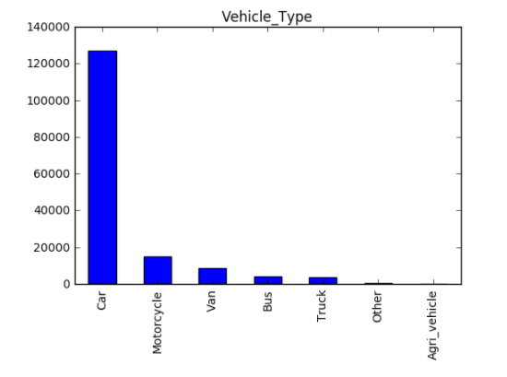
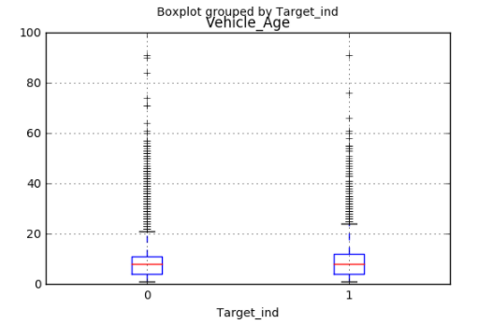
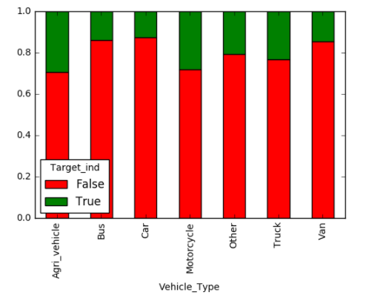
Data Understanding
Frequency Chart
100 % Stacked Bar Chart
Box Plots

Slide 7



Modelling Approach
Software Used
Training/ Test Split
70/30 split
Undersampling non-target observations in training set
Modelling Techniques
Logistic Regression
Decision Tree
Feature Selection
Recursive Feature Elimination Cross-validated
Data Understanding & Analysis
Support Vector Machine
Recursive Feature Elimination

Slide 8
Final Models
Model 1: Logistic Regression
Model 2: Decision Tree
Model 3: SVM
42/45 variables were inputs in the final model
Final model input variables include:
VM_Reversing_ind (where the vehicle was reversing at time of accident)
Veh_Motorcylce_ind (where the vehicle type was a Motorcycle)
Jackknifed_ind (where the vehicle was jackknifed)
Overturned_ind (where the vehicle was overturned)
39/45 variables were inputs in the final model
Criterion was set to ‘entropy’ rather than the default ‘gini’
The maximum depth was set to 10
Final model input variables include:
Male_ind (driver was male)
Urban_ind (accident occurred in urban area)
14/45 variables were inputs in the final model
Loss was set to ‘hinge’
Kernel was set to ‘linear’
The maximum iterations was set to 5000.
Final model input variables include:
VM_U_Turn_ind (vehicle was making a U-Turn)
POI_Back_ind (the point of impact was the backside)

Slide 9
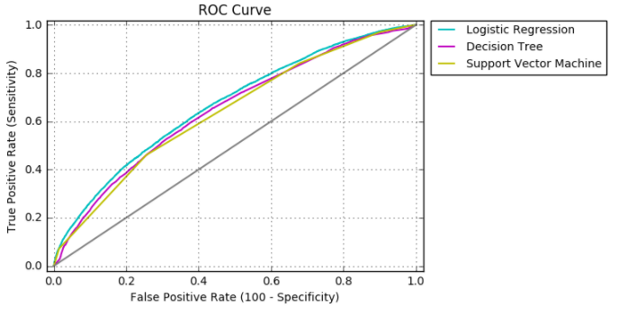
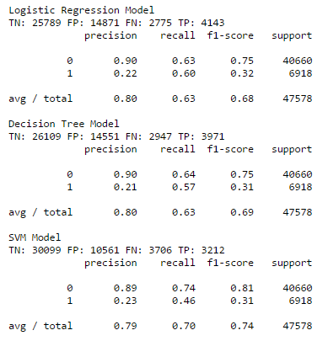

Evaluation

Slide 10
In Summary
The overall performance of all 3 models was not good
The Logistic Regression model was the most suitable
Model could still improve overall fraud investigation process by improving efficiencies of time
Model probabilities can be used to prioritise which claims to investigate i.e. claim of serious injury but model says likelihood of accident resulting in serious injury is low then investigate claim
Model can be used alongside other fraud detection models

